Slide 1

IoT Based Sensing and Security Management System
Made by: Somil Sharma
Registration Number: 1031330128
Project Guide:
Mr Mrityunjay Singh

Slide 2
Time Management
Phase | Duration | Status
Requirement | 28/11/16 – 0/1/17 | Completed
Analysis | 10/1/17 – 20/1/17 | Completed
Design | 20/1/17 – 27/1/17 | Partially Completed
Implementation | 27/1/17 – 30/3/17 | Partially Completed

Slide 3
Introduction
As the self-explanatory name would suggest, this project has been designed to act as a security system that can be accessed to keep a check on a computer/server from any corner of the world. It consists of a hardware component and a software application linked to it, in order to enable the most novice user to access it with ease. The secondary objective of this project is to further the use of budding Python modules in modern day projects (ones even beyond the scope of this one) and develop the most inexpensive personal security system possible.

Slide 4
Existing Problem
In a world where information is power and security is factually considered to be a myth, every person living on this planet is threatened by the fallout of getting hacked. We’re a part of a civilization which is entirely founded on internet and it’s services. From every password and pin number you’ve ever created to your very private thoughts, all of it can be breached and accessed. And even though we’re all aware of these threats, none of us ever take measures to safeguard this information with utmost gravity mainly for two reasons:

Slide 5
Most security firms offer physical security, that too marketed for big companies and organisations, not regular people.
The security services designed for and acquired by regular people are high-priced, to be renewed regularly and only provide security in physical sense, not virtually.

Slide 6
Proposed Solution
The first thing this project does eliminates the role of a third-party in the delivery of the service. This makes the users directly in charge of their own system’s security, therefore simplifying the process and turning the security system into a one time investment, no renewals.
Second, it allows the user to keep track of the system wirelessly and monitor it from any part of the world.

Slide 7
The project also includes a platform independent desktop application which uses data abstraction to make the operation of the system easier for the user. There is zero knowledge of python, SOC, IOT or any form of coding required for someone to manage the security system.

Slide 8
Methodology
System On Chip(Raspberry pi)
Open source IoT online application
User
First mode of Operation:
User
Open source IoT online application
System On Chip(Raspberry pi)
Second mode of Operation:

Slide 9
Algorithm
Accessing open source IOT(Internet of Things) application to ping the sensors.
Retrieving data for the sensors as it is stored on a JSON file on the open source application itself.
Decoding the JSON file to access sensor data with the given time lapse and representing it graphically by plotting it.
Based on the evaluation of data collected, activating the second sensor to ensure the security of the system.

Slide 10
If the data from the second sensor also suggests foul play, the user can decide either to defend his system or attack the intruder.
System can either be defended by disconnecting it from all networks or by completely shutting it down (utilizing shell scripting).
The intruder can be attacked by transmitting a worm file into his/her network via a ssh channel, while retrieving the identity of his system (utilizing socket programming).

Slide 11
Progress Achieved
Raspberry pi has been set-up with the Noobs Operating System.
Raspberry Pi’s pin configuration has been set-up and proper connections have been made.
Algorithms for Socket programs for transmitting data to the IoT website and retrieving it from the same have been laid out.
Application Design has been prepared at the most basic stage.

Slide 12
Majority of application’s windows have been coded with functioning code.
Motion sensor has been set-up to send and receive live data feed.
Thingsspeak channels have been setup and connected to the raspberry pi to receive and trigger real time data.
A login page has been introduced in the application using SQL Lite.

Slide 13
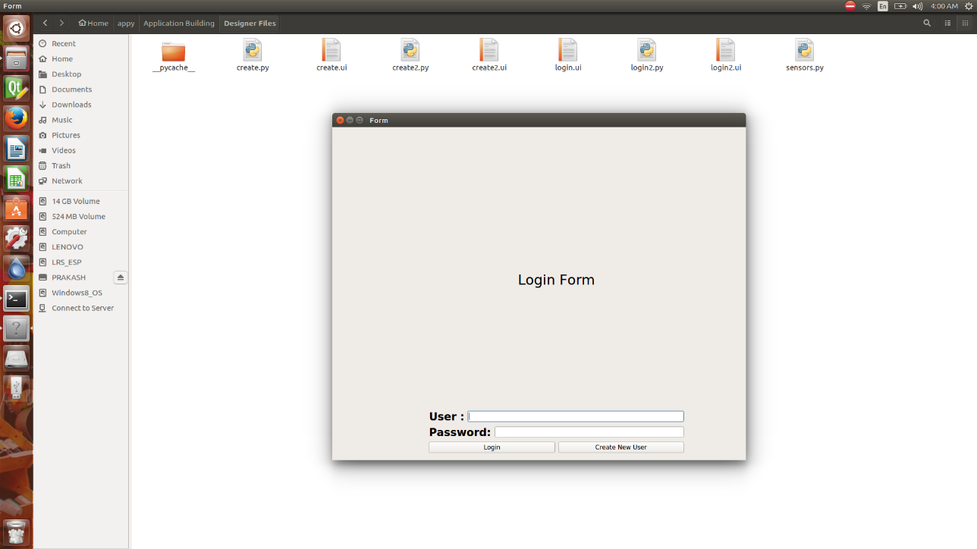
Screenshots

Slide 14
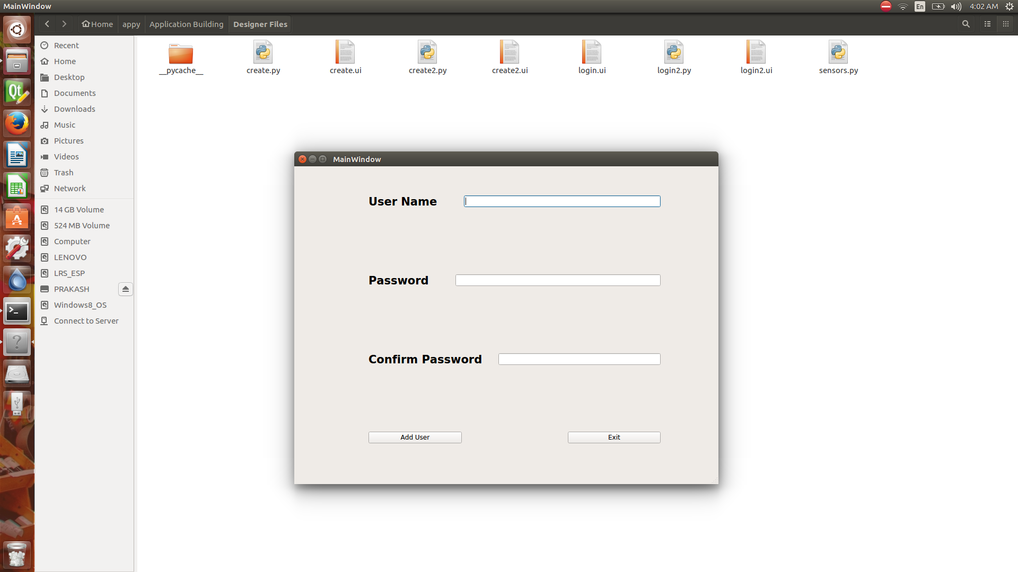

Slide 15
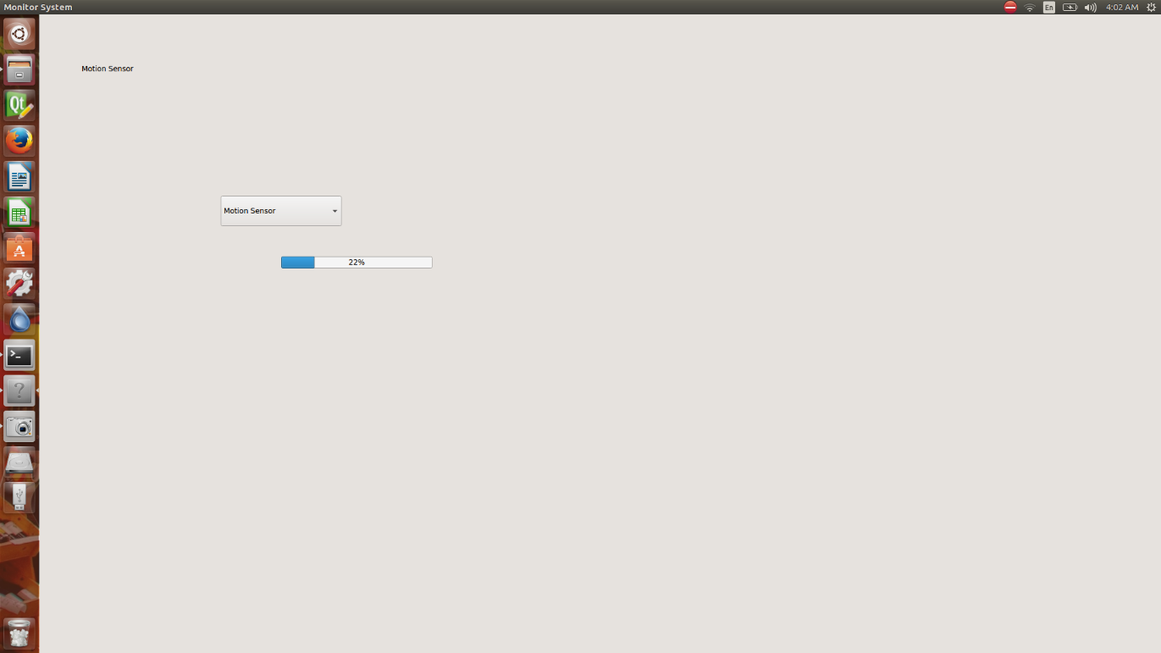

Slide 16
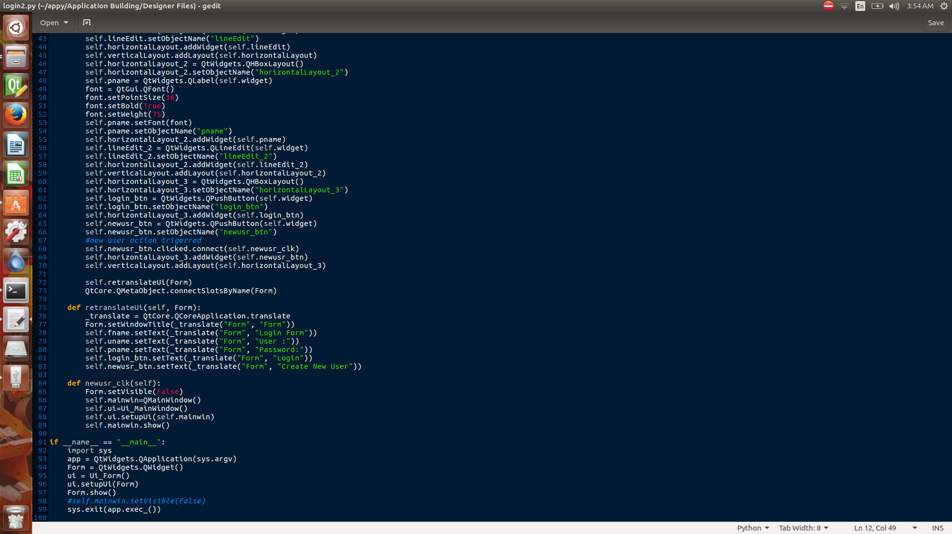

Slide 17
Hardware Specifications:
System on Chip (Raspberry pi)
Class 10 MicroSD Card (Recommened)
Temperature and Motion Sensor
Connecting cables, Ethernet Cable
Processor (Pentium 4 and above)
RAM (512 MB and above)

Slide 18
Technology Used
Software Specifications:
Platform: Linux
Technology:
Raspbian/Noob OS
Python 3.5
Internet of Things (IoT)
PyQt5 Module
Linux bash shell scripting
SQL Lite
Networking

Slide 19
Thank You

